Slide 1
LHC & ATLAS
The largest particle physics experiment in the world

Slide 2
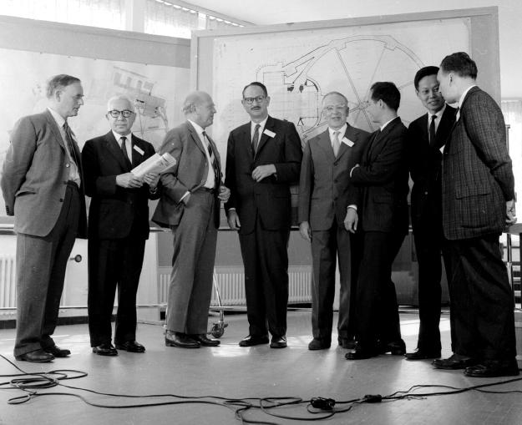
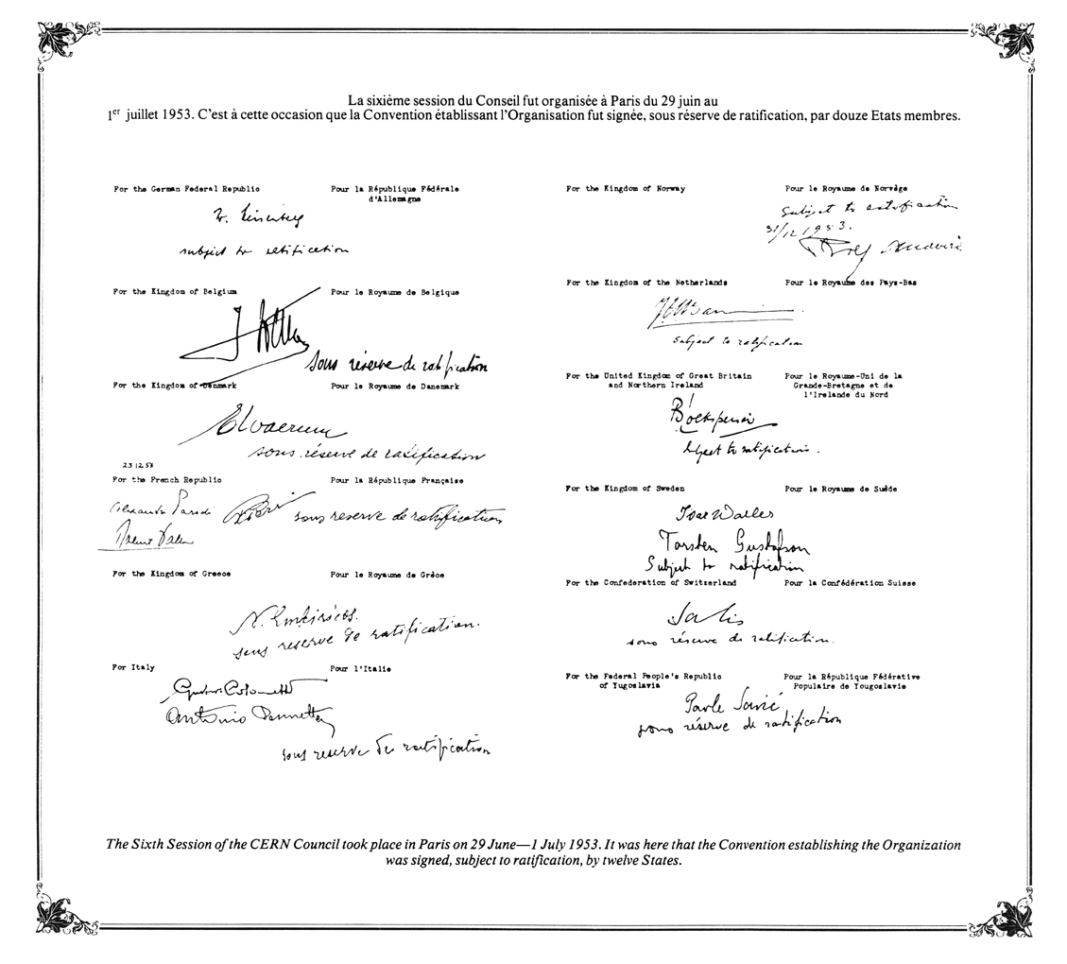
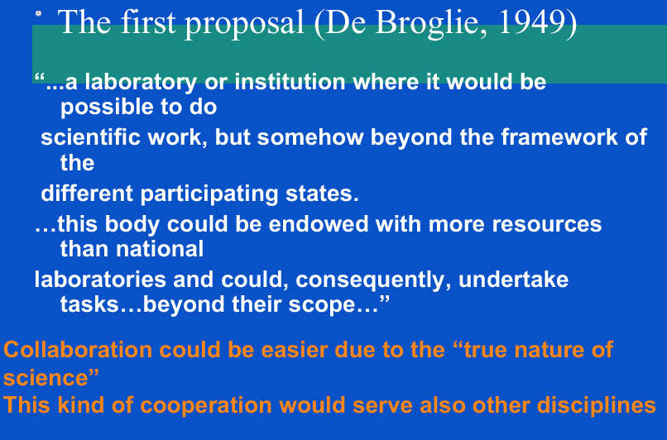
CERN – A laboratory for the world
CERN was founded in 1954
Torsten
Gustavson
There were 12
member states
in the beginning.

Slide 3
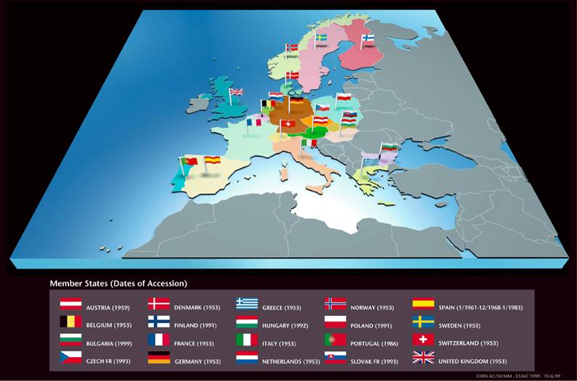
The 20 member states
OBSERVERS:
  UNESCO
  EU
  Israel
  Turkey
SPECIAL OBSERVERS
(for the LHC):
  USA
  Japan
  Russia
  India

Slide 4
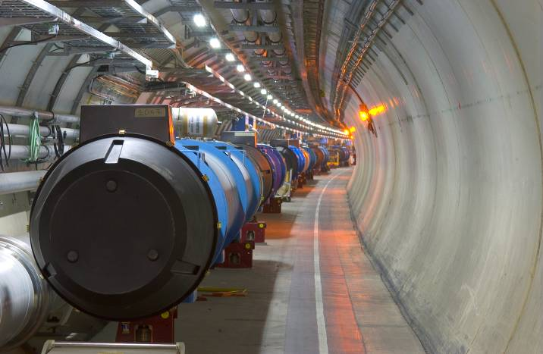
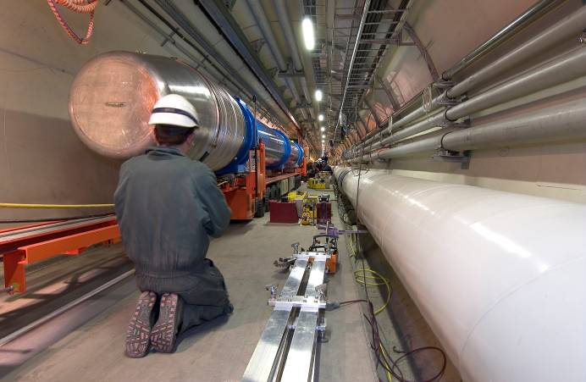
The Large Hadron Collider (LHC)
The 27 km long proton-proton collider was ready to start in the autumn of 2008.

Slide 5
The Large Hadron Collider (LHC)
The 27 km long proton-proton collider was ready to start in the autumn of 2008.
It consists of 1232 + 392 superconducting magnets.
Vincent Hedberg - Lund University
5

Slide 6
The Large Hadron Collider (LHC)
The 27 km long proton-proton collider was ready to start in the autumn of 2008.
It consists of 1232 + 392 superconducting magnets.
The maximum collision energy: 14 TeV
However, the collision energy is 1150 TeV when Pb-atoms are used.
Vincent Hedberg - Lund University
6

Slide 7
The Large Hadron Collider (LHC)
The 27 km long proton-proton collider was ready to start in the autumn of 2008.
It consists of 1232 + 392 superconducting magnets.
The maximum collision energy: 14 TeV
However, the collision energy is 1150 TeV when Pb-atoms are used.
The proton velocity is
99,999999991% of the speed of light.
Vincent Hedberg - Lund University
7

Slide 8
The Large Hadron Collider (LHC)
The 27 km long proton-proton collider was ready to start in the autumn of 2008.
It consists of 1232 + 392 superconducting magnets.
The maximum collision energy: 14 TeV
However, the collision energy is 1150 TeV when Pb-atoms are used.
The proton velocity is
99,999999991% of the speed of light.
One billion collisions per second.
Vincent Hedberg - Lund University
8

Slide 9
The Large Hadron Collider (LHC)
The 27 km long proton-proton collider was ready to start in the autumn of 2008.
It consists of 1232 + 392 superconducting magnets.
The maximum collision energy: 14 TeV
However, the collision energy is 1150 TeV when Pb-atoms are used.
The proton velocity is
99,999999991% of the speed of light.
One billion collisions per second.
The stored energy in one beam is 360 MJ. ( 360MJ ~ energy of a train travelling at 150 km/h or of an explosion of 77 kg of TNT).
Vincent Hedberg - Lund University
9

Slide 10
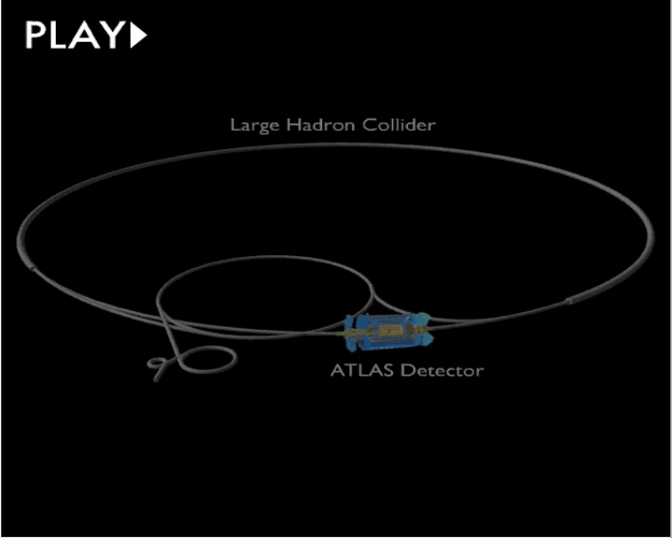
The Large Hadron Collider (LHC)
The protons are first accelerated in a linear accelerator. They are then accelerated in the PS and SPS synchrotrons and finally injected into the 27 km long LHC tunnel.
The protons are
travelling in
2808 bunches that
each contain
10¹¹ protons.
Vincent Hedberg - Lund University
10

Slide 11
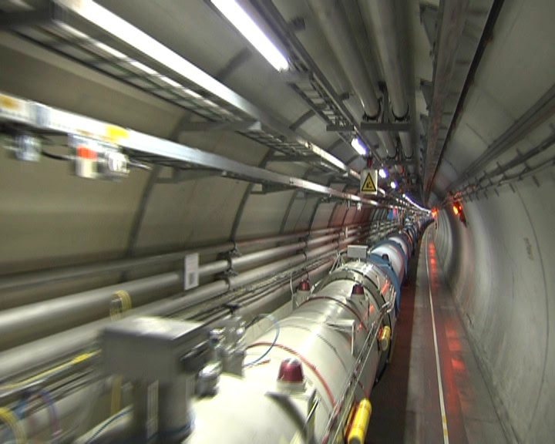
In the LHC accelerator tunnel
Vincent Hedberg - Lund University
11

Slide 12
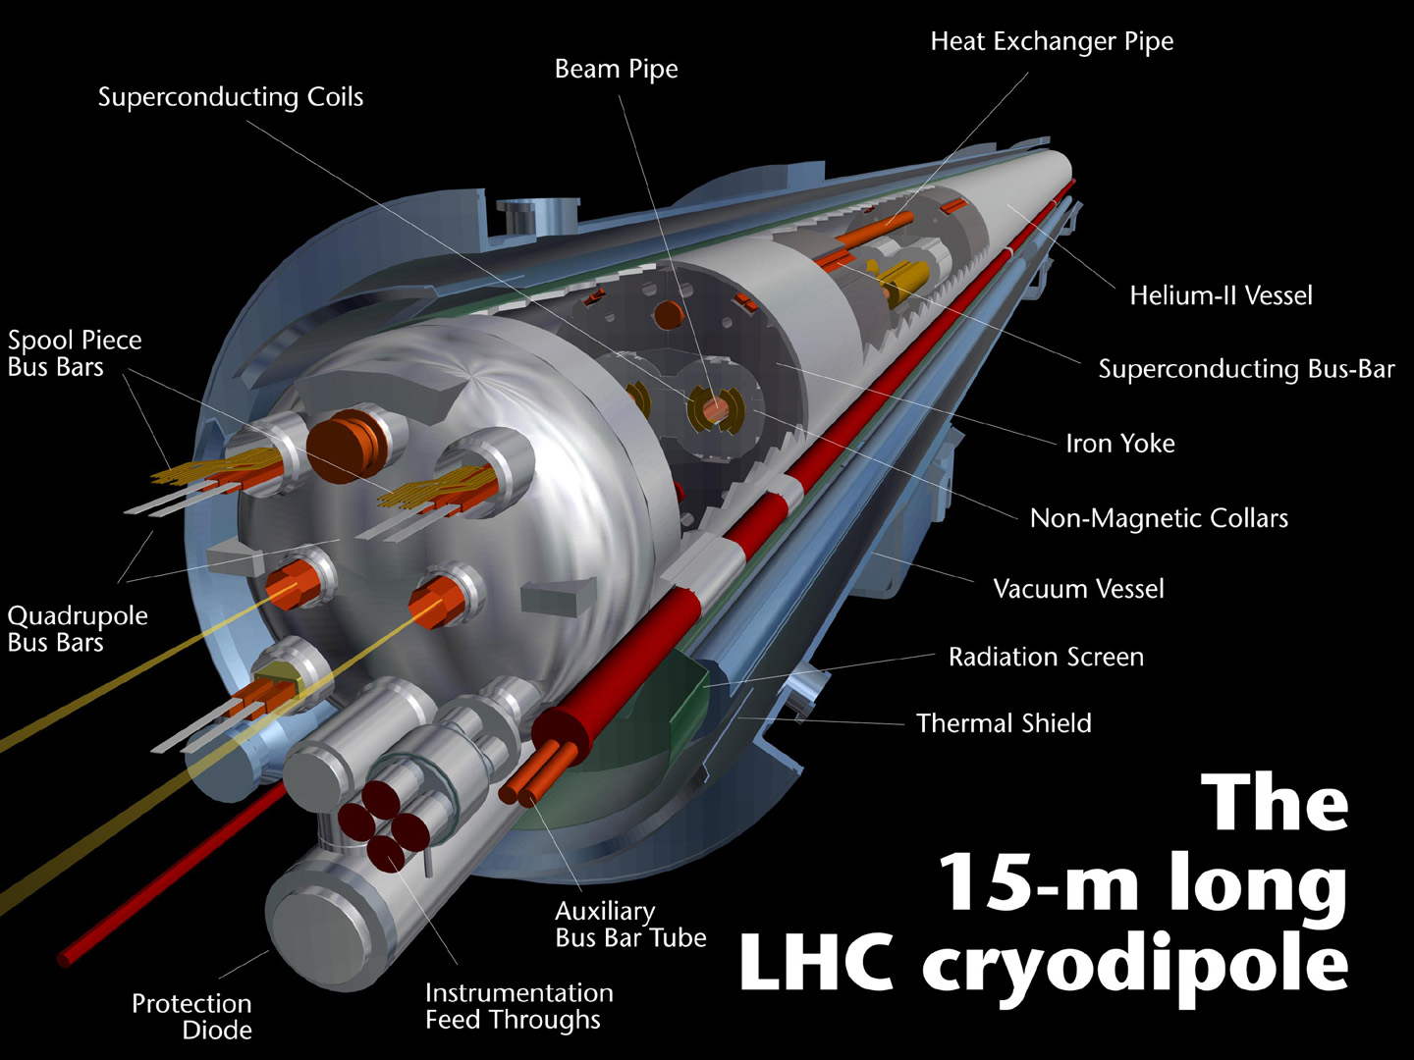
The magnets that bend the proton beams.
1232 dipole
magnets
15 m long
35 ton heavy
Magnetic field:
8.3 Tesla
120 tonnes of
liquid helium
(1.9 K)
Current:
11800 Ampere

Slide 13
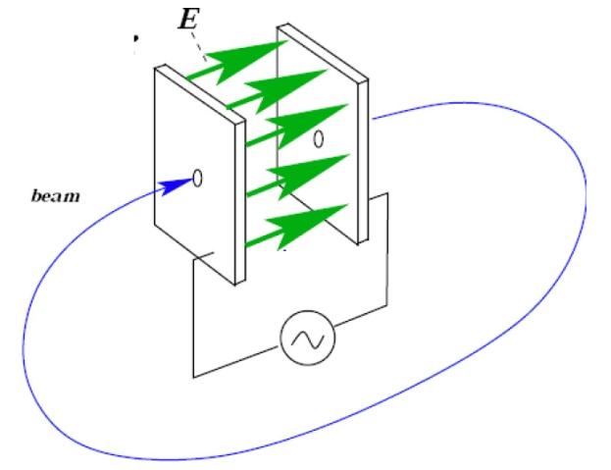
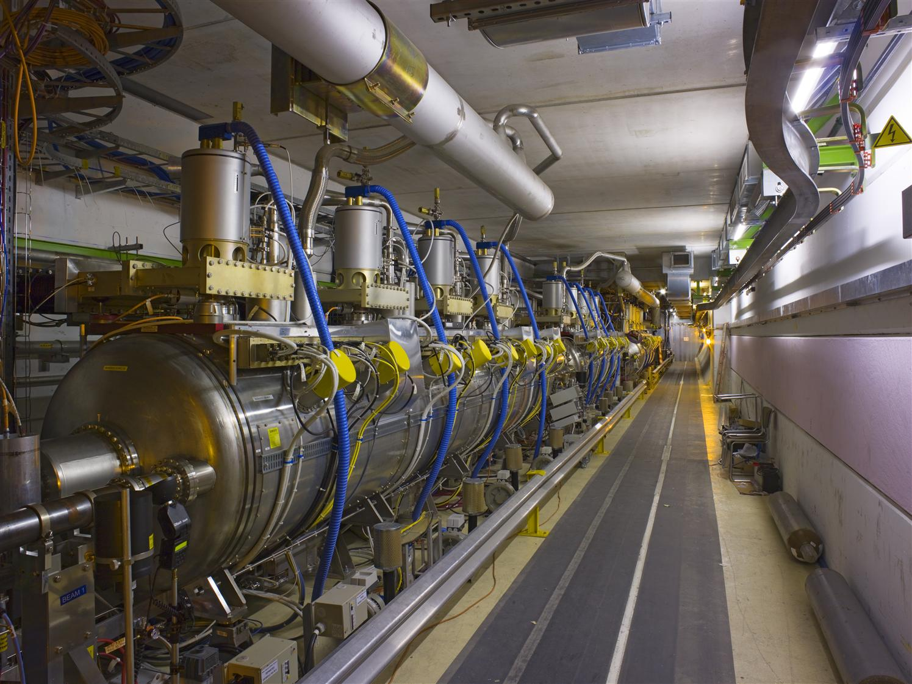
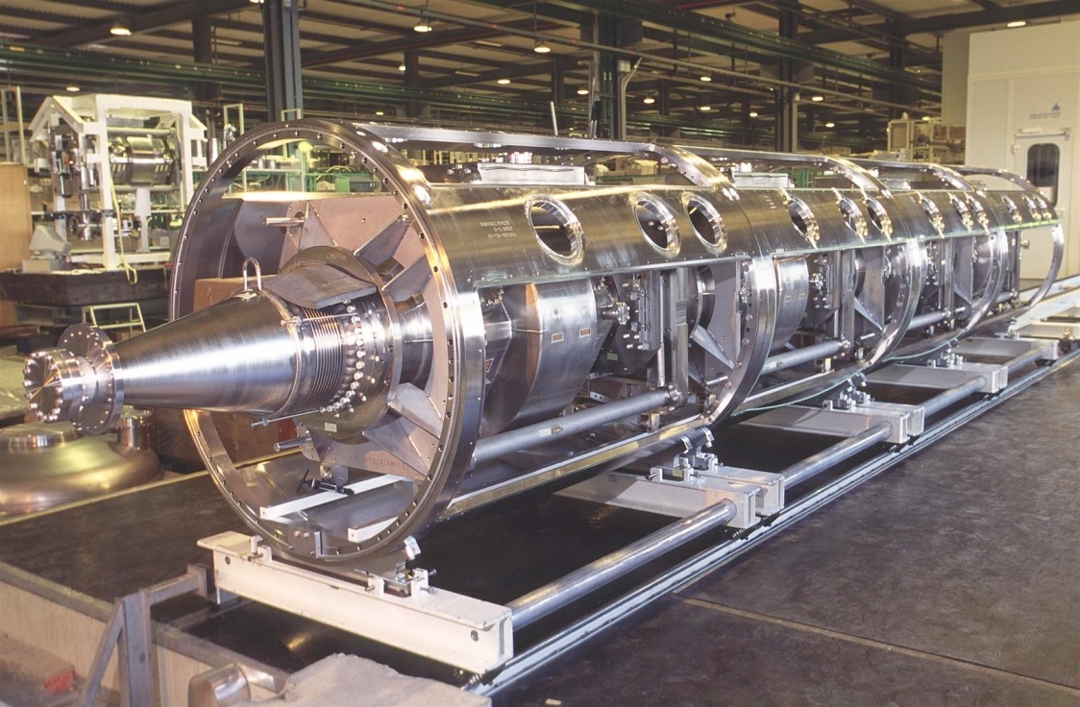
The cavities that provide the energy.
The magnets are used to bend the proton trajectories and to focus the beams.
Cavities with strong high-frequency electric fields are used to provide the energy to the beams. The LHC has 2x8 cavities that give 16 MV at 400 MHz.

Slide 14
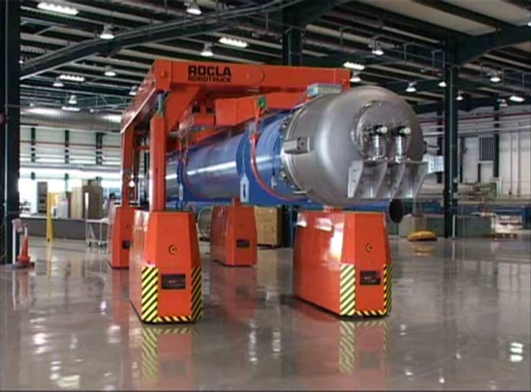
The building of the LHC

Slide 15
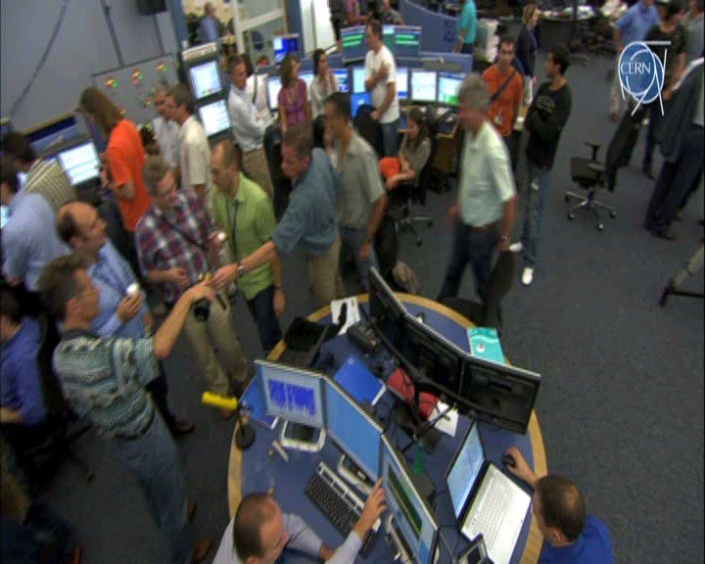
10 September 2008 – Champagne !

Slide 16
LHC – successes and failures
10 September 2008: Protons are circulating in the accelerator for the first time.
19 September 2008: A short circuit damages 53 magnets.
23 November 2009: The accelerator is repaired and protons are colliding for the first time at an energy of 0.9 TeV.
2010: The accelerator collides protons at 7 TeV (world record) and runs most of the year at low luminosity (few collisions per second).
2011: LHC runs at 7 TeV and a luminosity of 10³³ cm⁻²s⁻¹ (world record).
2014: LHC is planned to run at 14 TeV and a luminosity of 10³⁴cm⁻²s⁻¹

Slide 17
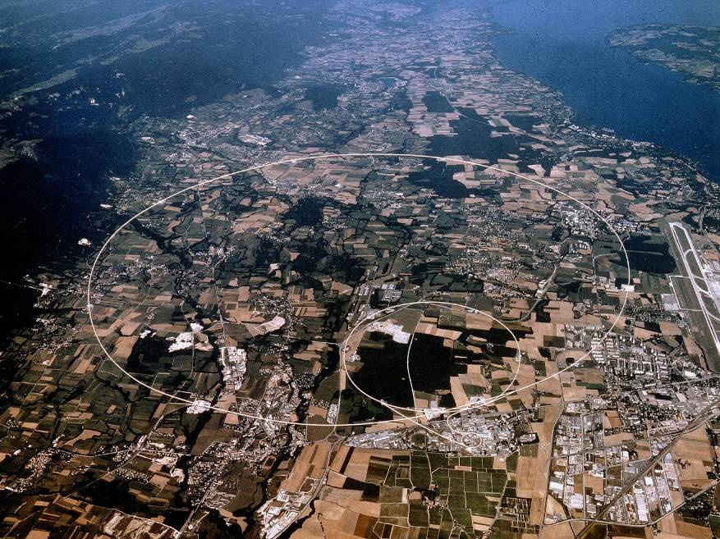
Experiments at the LHC
Experiments
ATLAS:
Proton-proton
collisions
CMS:
Proton-proton
collisions
ALICE:
Atom-atom
collisions
LHCb:
Proton-proton
collisions giving
b quarks
CMS
CERN
LHCb
ALICE
ATLAS
CERN

Slide 18





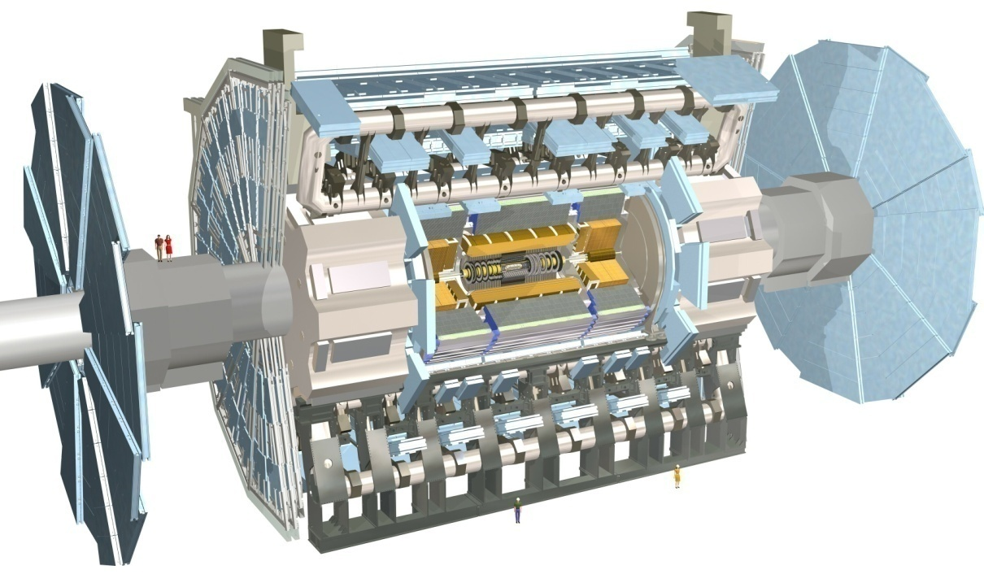
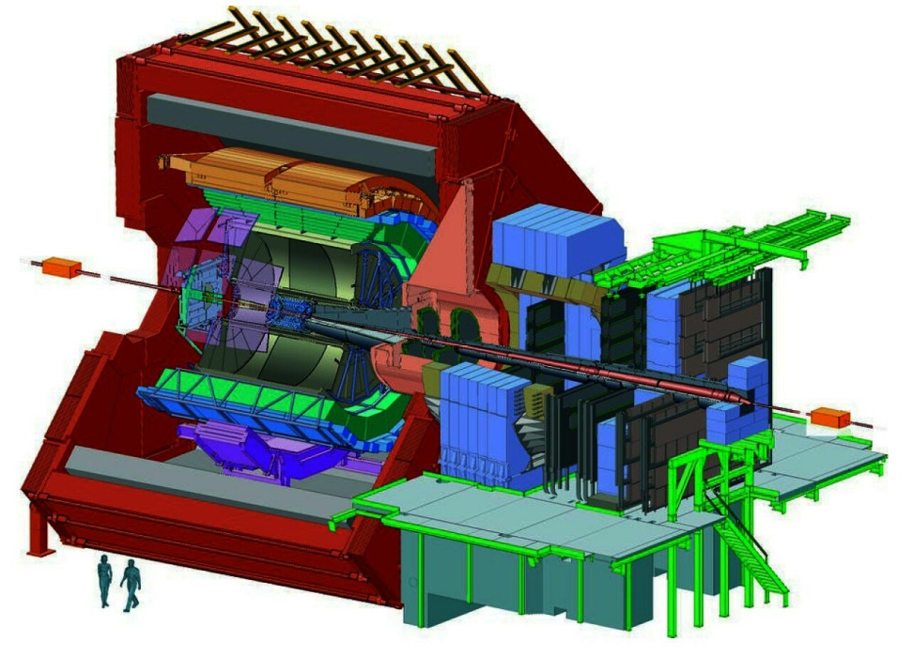
Swedish research groups
Uppsala
Universitet
The ATLAS experiment
The ALICE experiment
Vincent Hedberg - Lund University
18

Slide 19

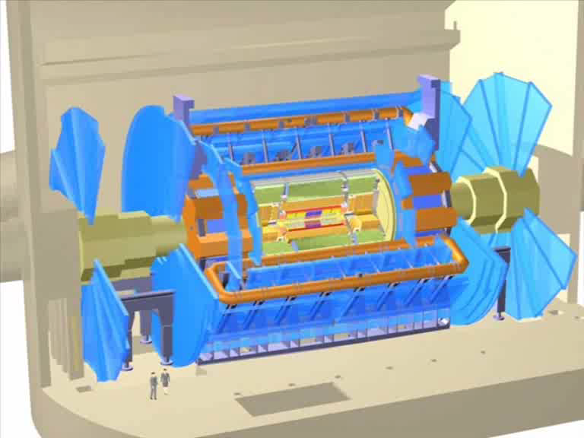
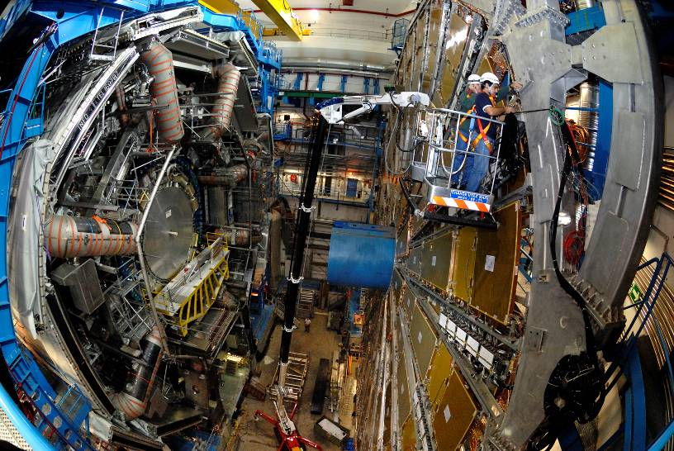
The ATLAS experiment
The ATLAS Experiment
Length: 44m
Diameter: 22m
Weight: 6000 tonnes
The collaboration
2900 physicists
(173 Univ., 37 Countries)
Muon detector
  Hadron calorimeter
    Electromagnetic calorimeter
      Tracking detector

Slide 20
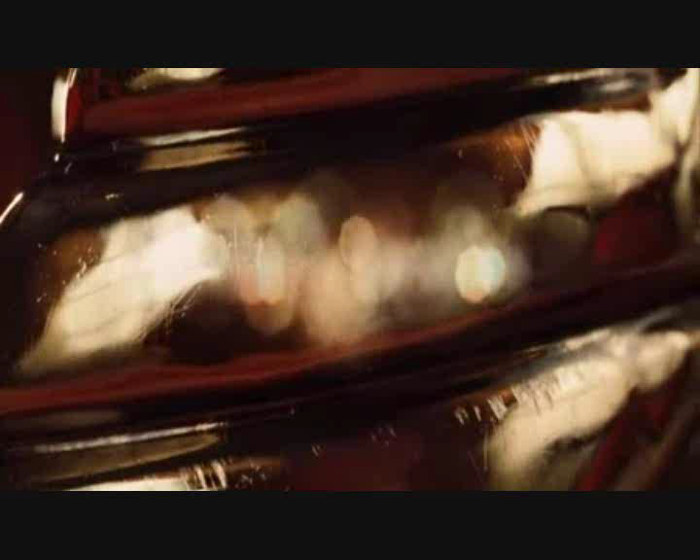
ATLAS in the movies
20
Vincent Hedberg - Lund University
20

Slide 21
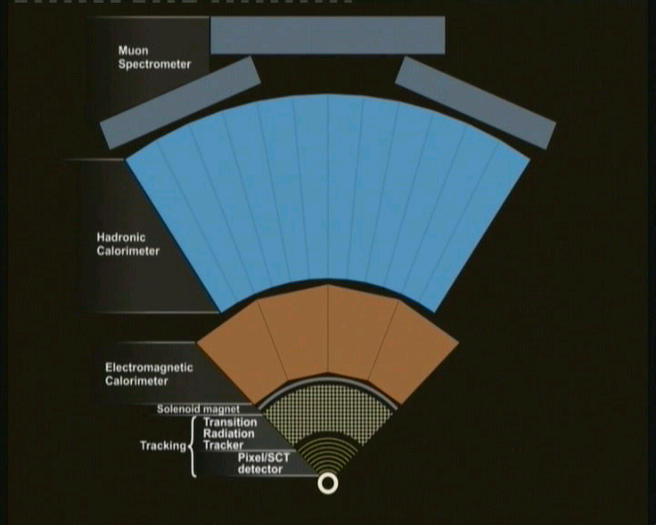
Detection of photons and electrons
Muon detector
Hadronic calorimeter
Electromagnetic
calorimeter
Tracking detector

Slide 22
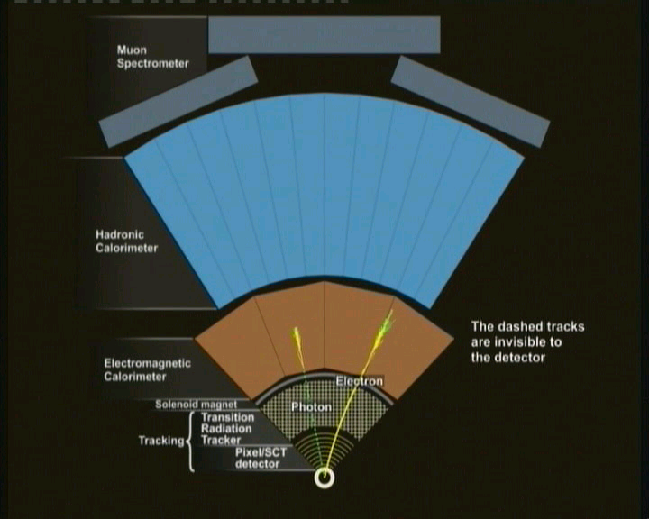
Detection of protons and neutrons
Muon detector
Hadronic calorimeter
Electromagnetic
calorimeter
Tracking detector

Slide 23

Detection of muons and neutrinos
Muon detector
Hadronic calorimeter
Electromagnetic
calorimeter
Tracking detector

Slide 24
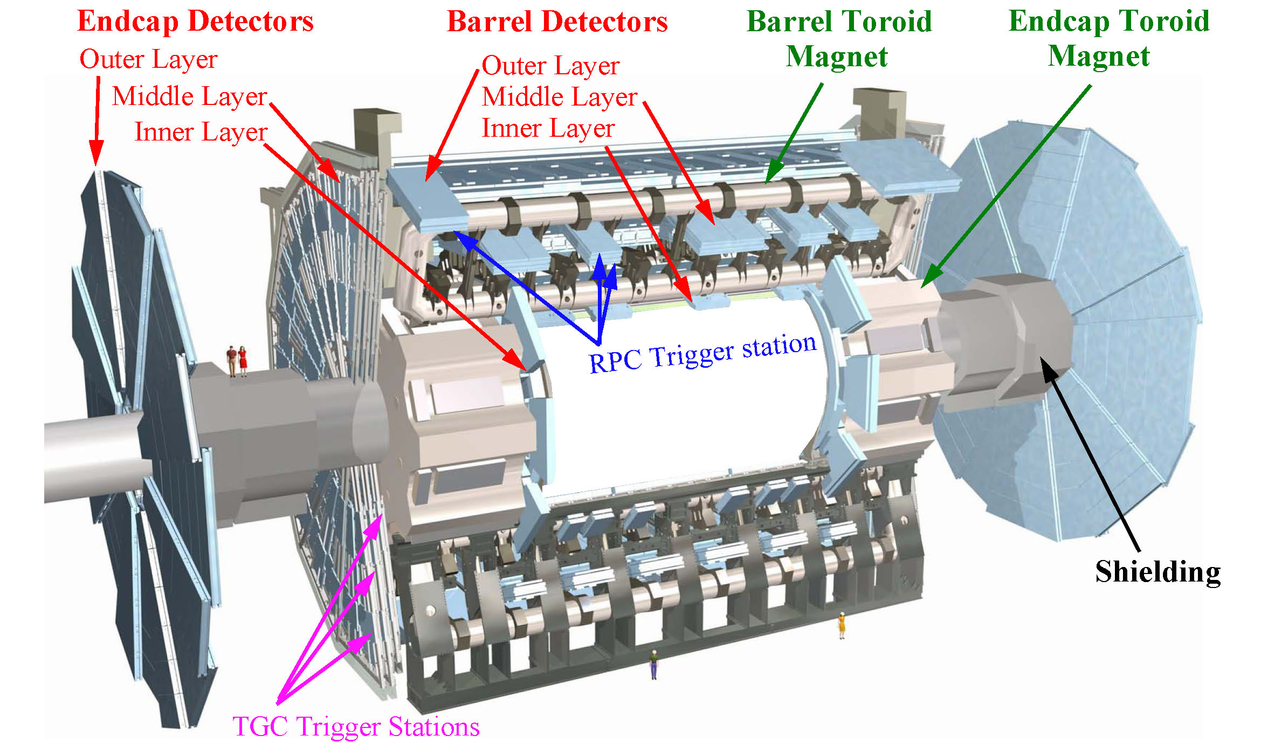
ATLAS: the muon system

Slide 25
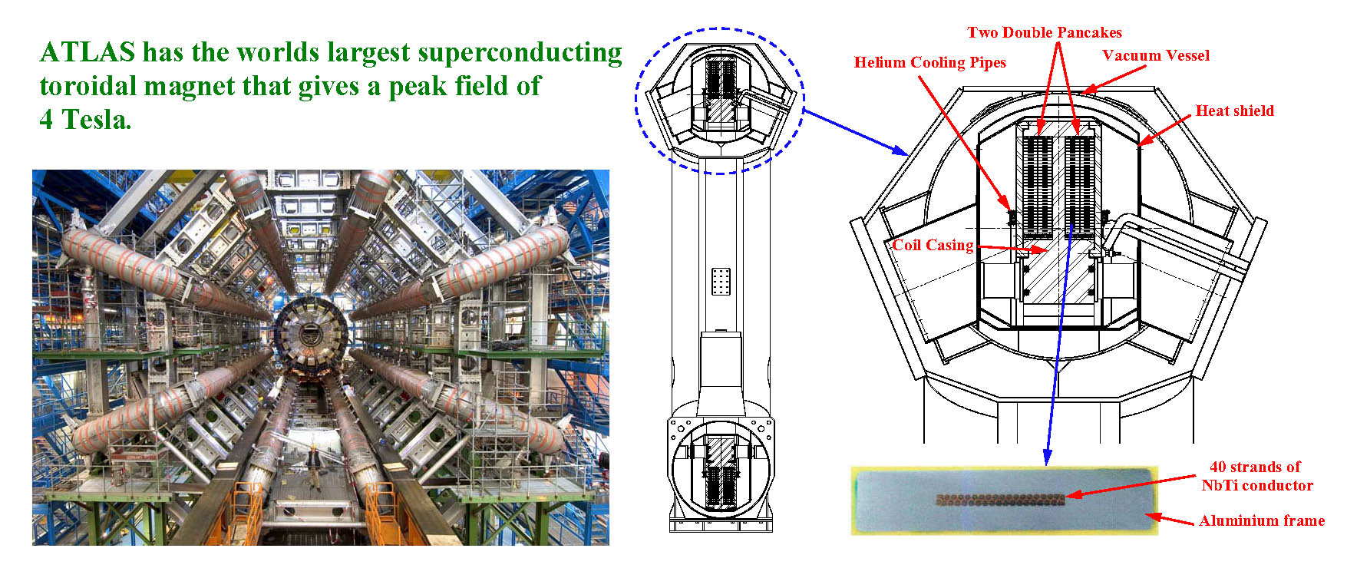
ATLAS: The 3 large toroidial magnets
The barrel magnet

Slide 26
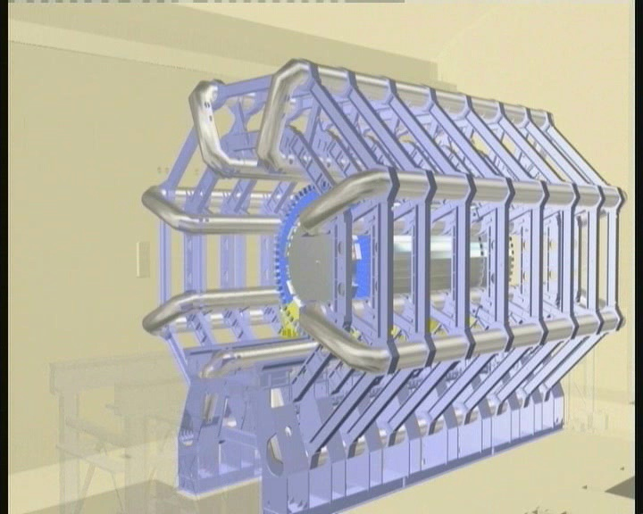
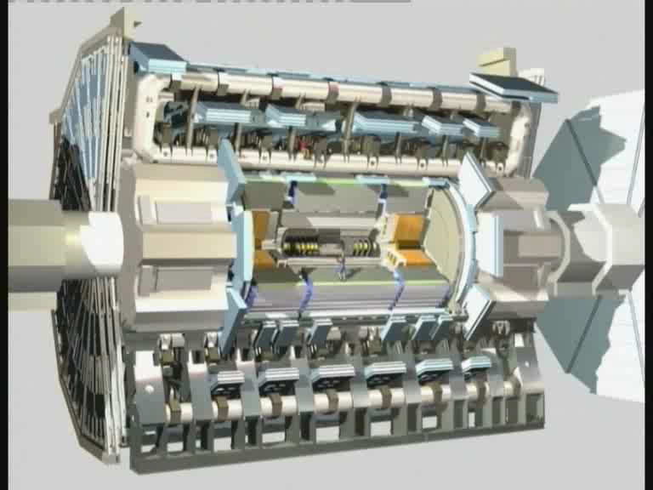
ATLAS: the muon detector
Installation of the muon detectors.
How do they work ?

Slide 27
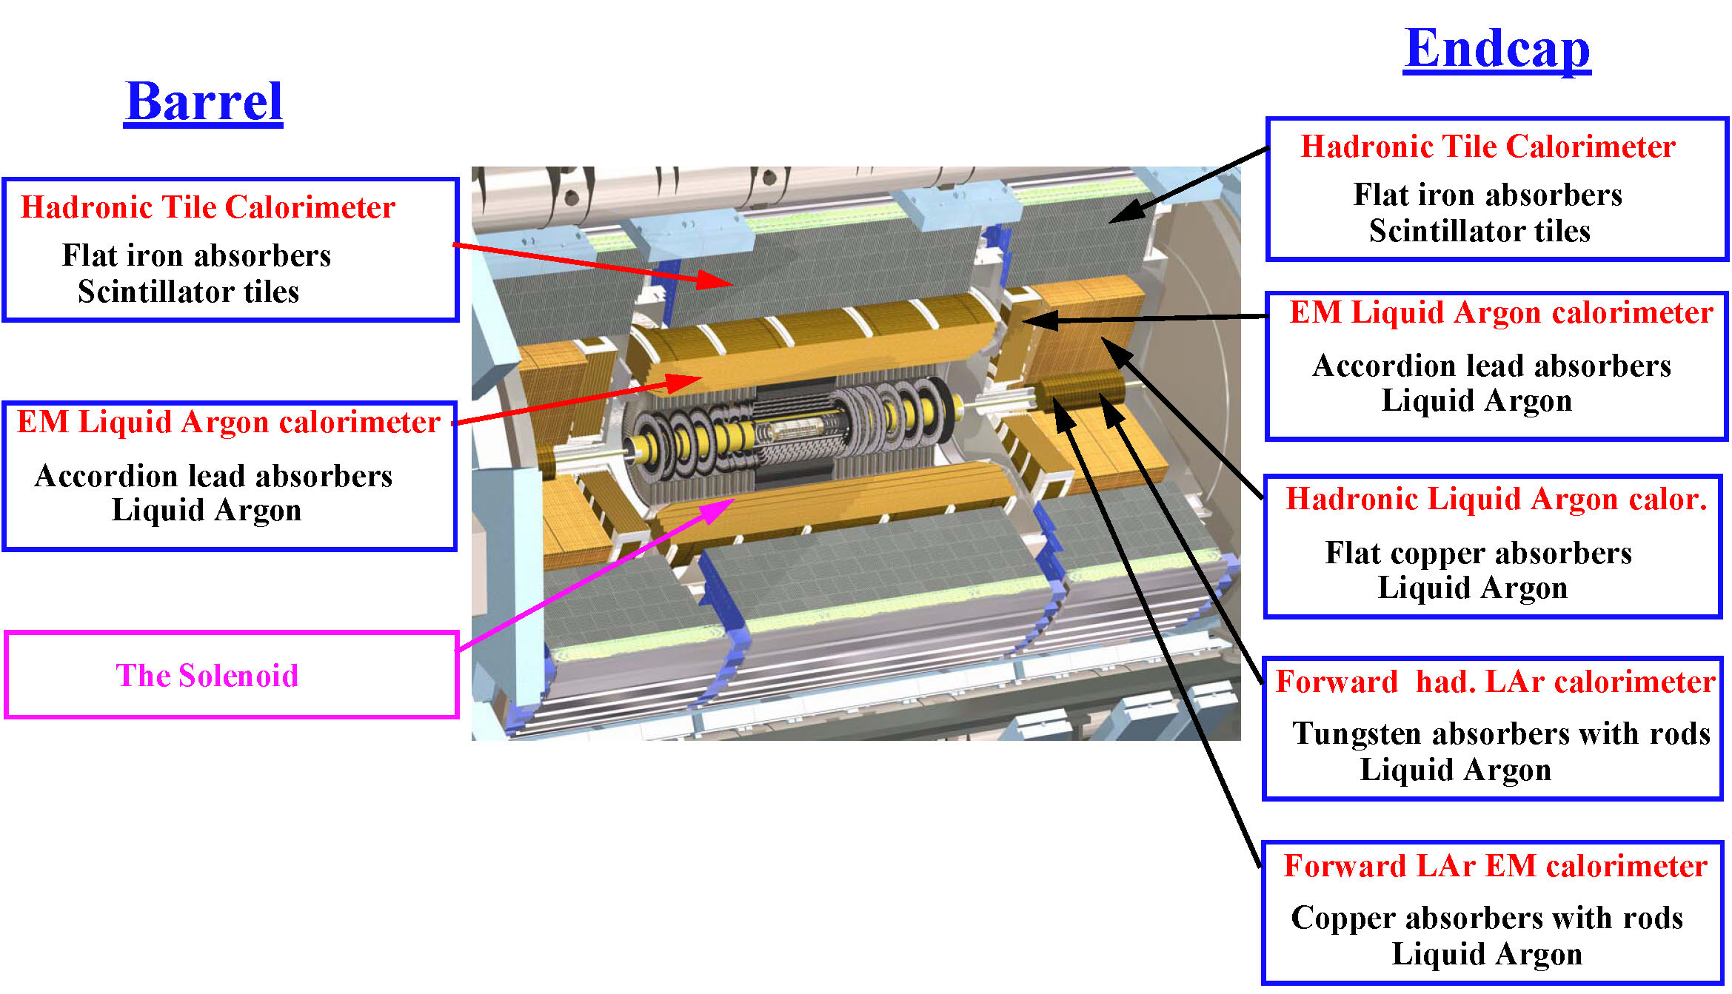
ATLAS: Calorimeters

Slide 28
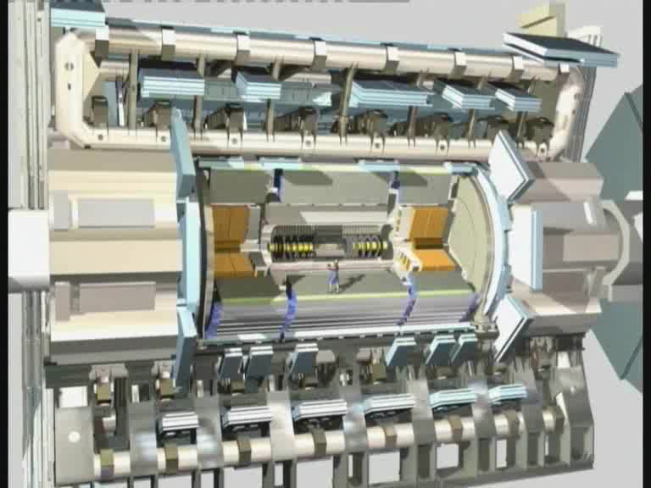
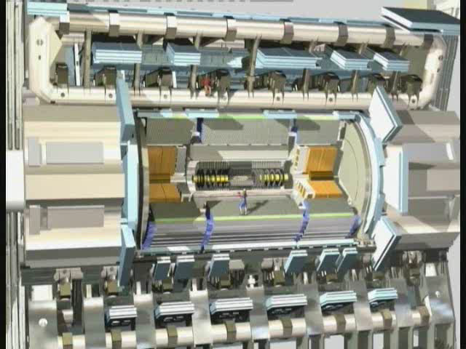
How does the calorimeter work ?
The electromagnetic calorimeter
is used to study photons and
electrons.
The hadronic calorimeter
is used to study hadrons, i.e.
particles that contains quarks
such as protons and neutrons.

Slide 29
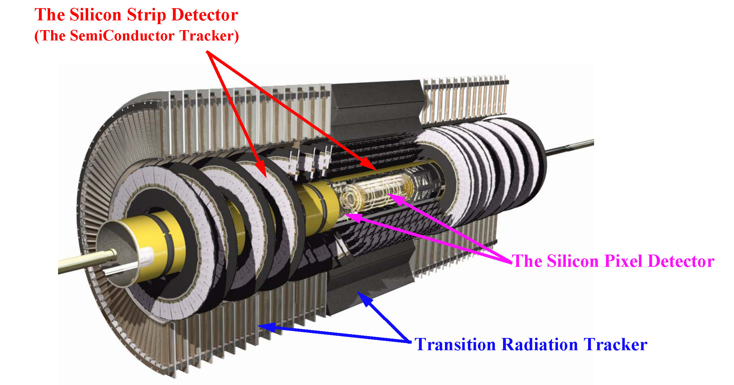
ATLAS: The Tracking Detector
Vincent Hedberg - Lund University
29

Slide 30
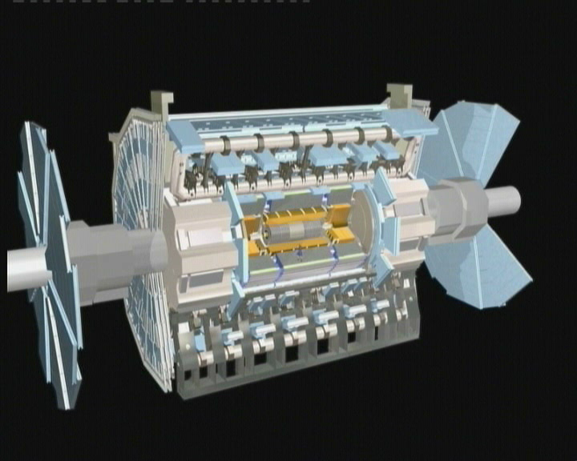
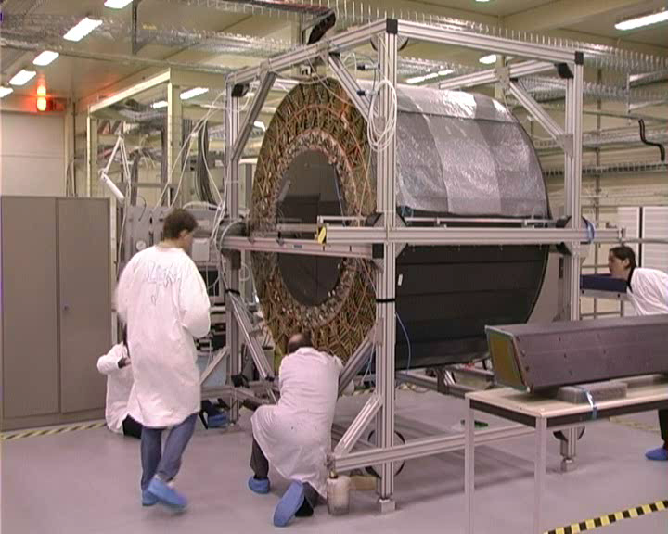
The Transition Radiation Tracker
The Transition Radiation Tracker (TRT) is used to measure the tracks
of charged particles and to identify electrons.
How does it work ?
Building the detector

Slide 31
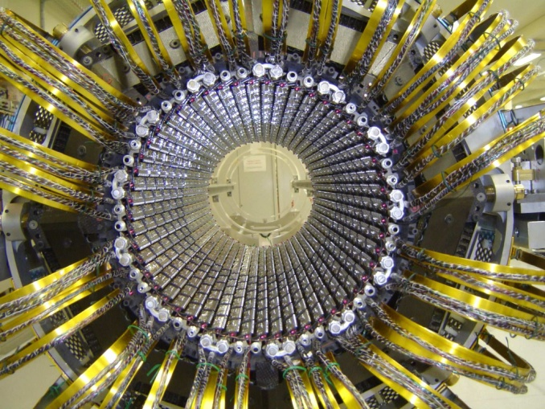

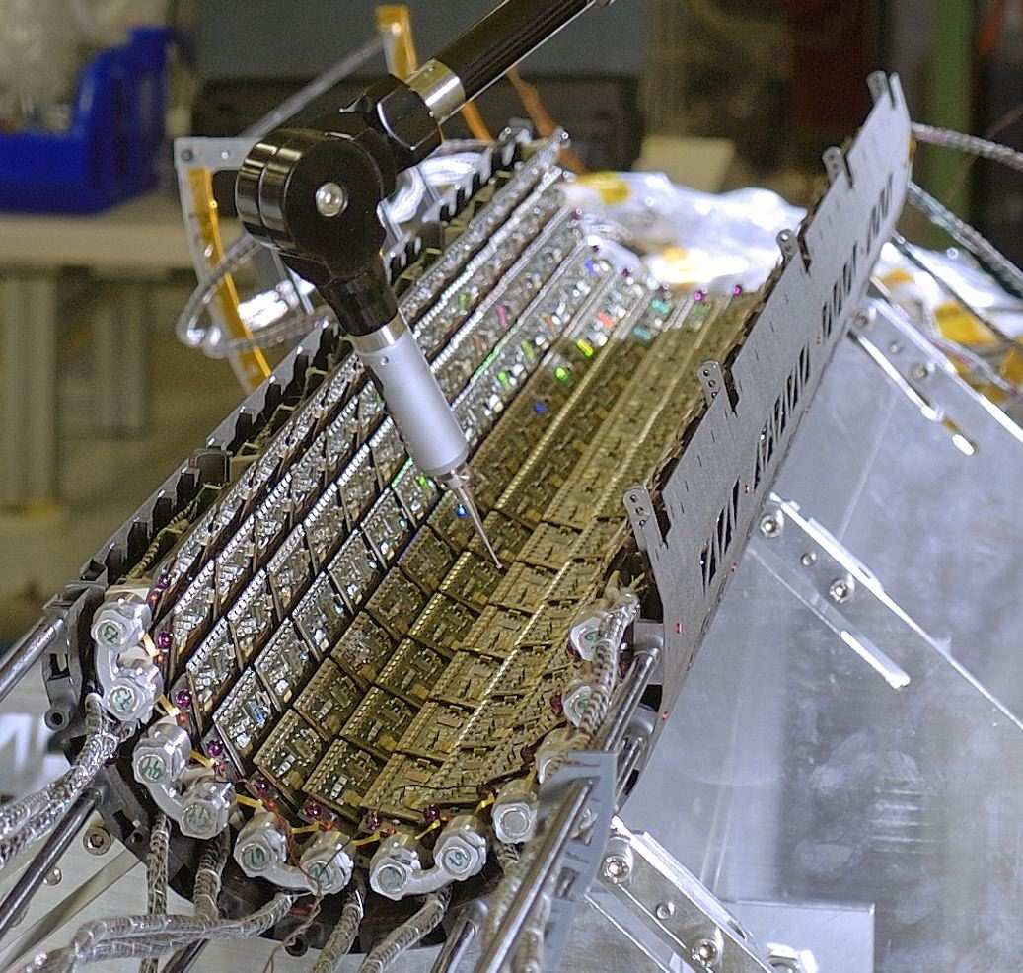
Silicon detectors in ATLAS

Slide 32
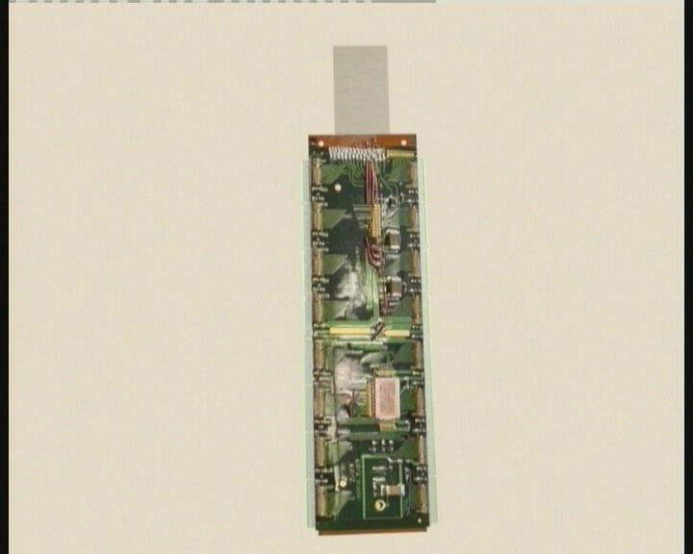
Silicon detectors: How do they work ?

Slide 33
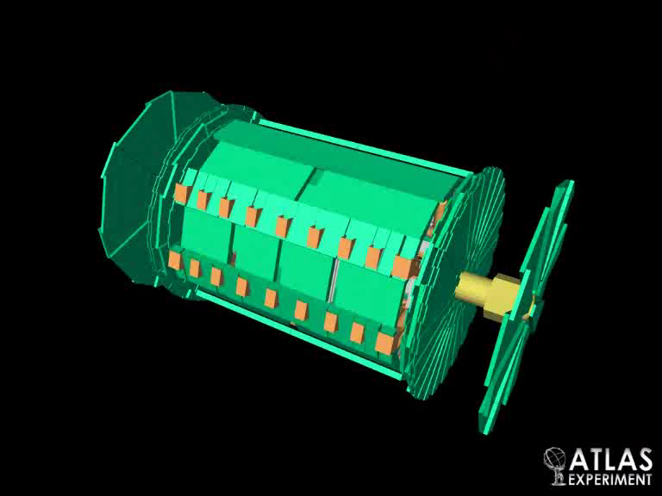
One of the first collision in ATLAS

Slide 34
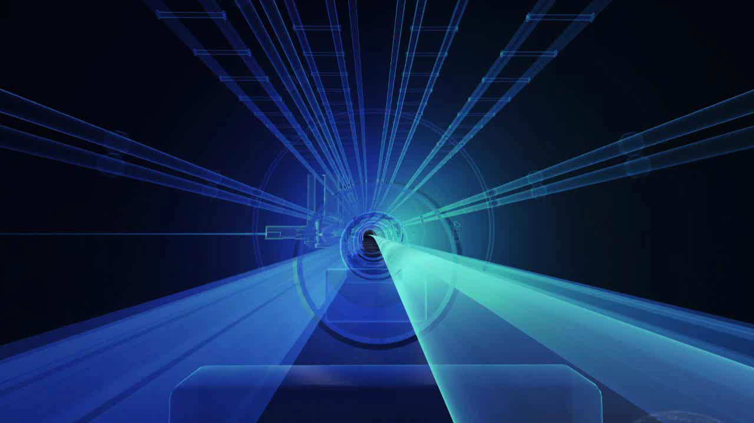
A lead-lead collisions in ATLAS

Slide 35
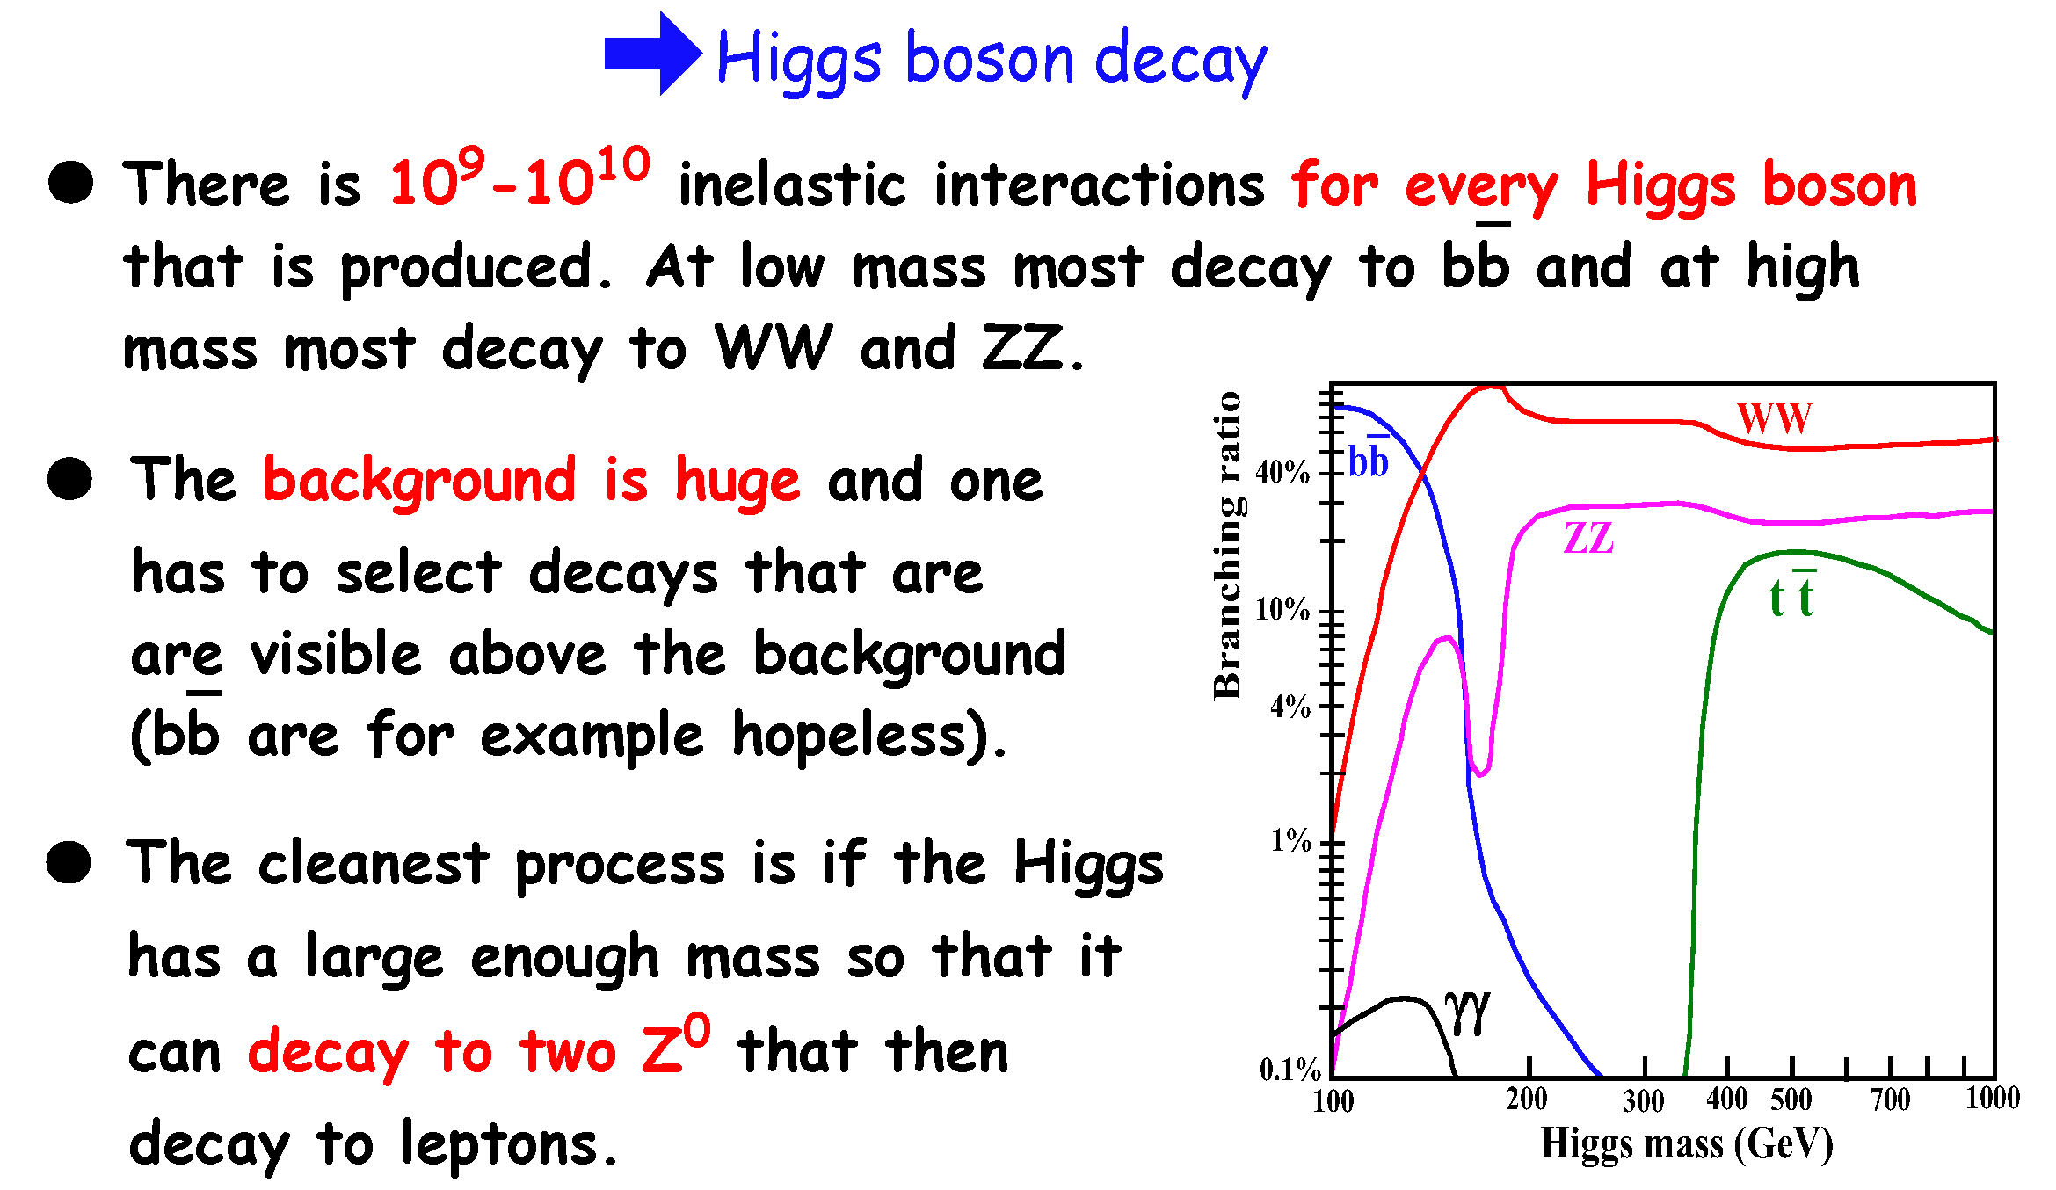
Physics studies:
Search for the Higgs particle

Slide 36
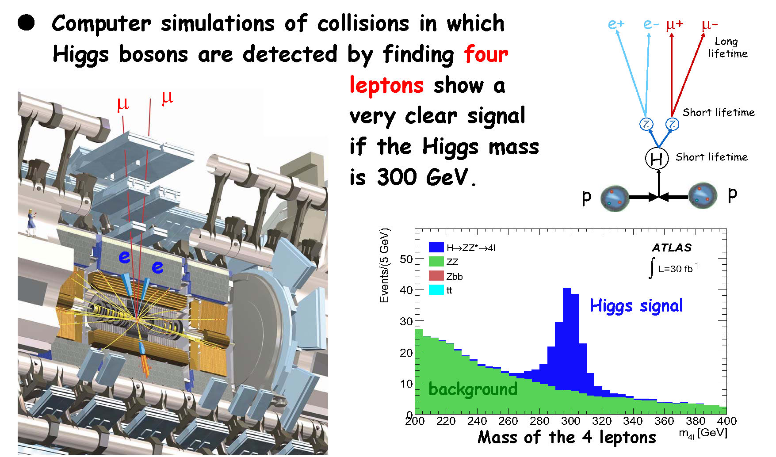
Physics studies:
Search for the Higgs particle

Slide 37

Physics studies:
Search for black holes
Black Hole
Signature:
Many particles and particles with a high energy and with a large angle with respect to the proton direction.
The holes will disappear after
10⁻²⁶s according to the theory
(if they are produced).

Slide 38
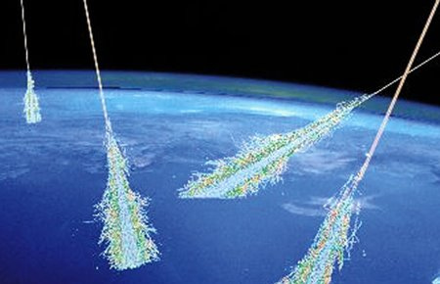
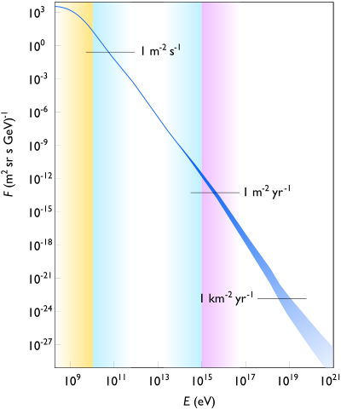
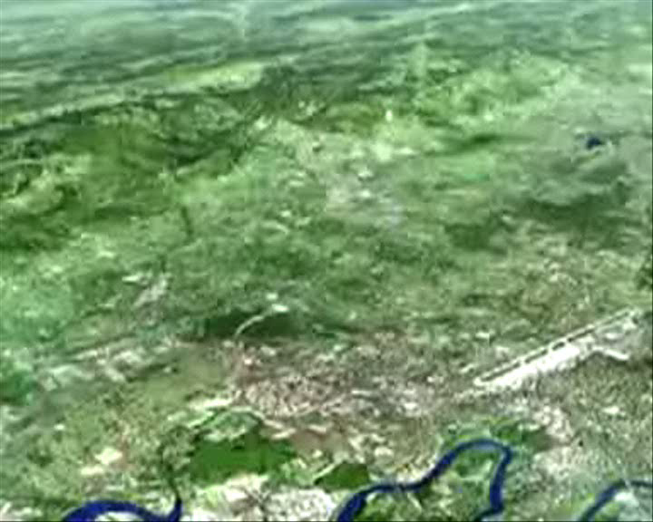
Black holes = The end of the world ?
Energy spectrum
Cosmic radiation
There are protons in the cosmic radiations with a higher energy than what can be produced by LHC. The number of collisions at LHC during one year corresponds to about 1000-10000 years of collisions in the atmosphere.
LHC

Slide 39
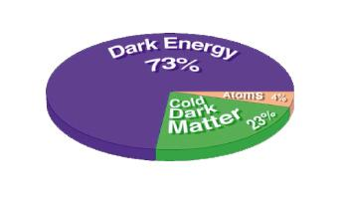
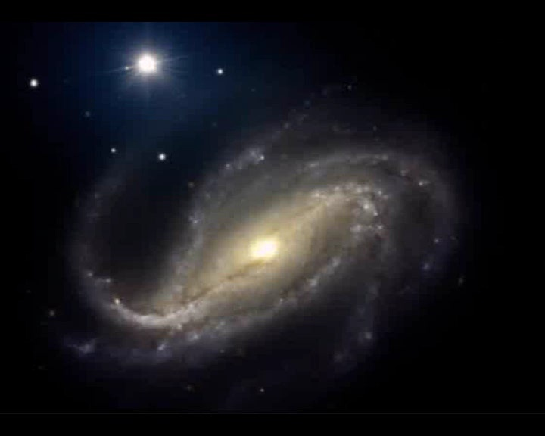
What other problems remain to be solved ?
Dark Matter
The rotational speed of stars in some galaxies are too high to be explained by the known matter.
This unknown matter could consist of new particles that can be discovered in ATLAS.
Dark Energy
The universe is not expanding with a constant speed. It seems that there is an unknown repulsive force between the galaxies. This force is thought to be caused by a mysterious dark energy.

Slide 40
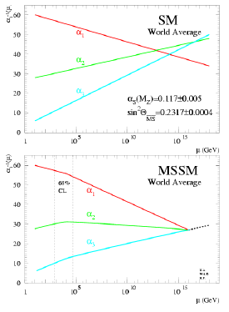
What other problems remain to be solved ?
Unification of the forces
Motivated by theory:
The strength of a force depends on the energy in the interaction in which it is
being studied.
If the strength of the different forces is the same at some very high energy, then this could be due to all forces being parts of the same unified force.
A similar phenomena is known from the theory that describes both the weak and the electromagnetic force.
The known forces looks at the moment to be almost unified at some large energy.
The confirmation could be given by new particles discovered in ATLAS.

Slide 41
What problems remain to be solved ?
What is dark energy ?
What is dark matter?
What happened with the
anti-matter ?
How does particles obtain their
mass ? (Higgs ?)
Why is the gravitation so weak ?
(Extra dimensions ? Black holes ?)
Are the different forces the same thing ?
LHC can perhaps
give the answer

Slide 42
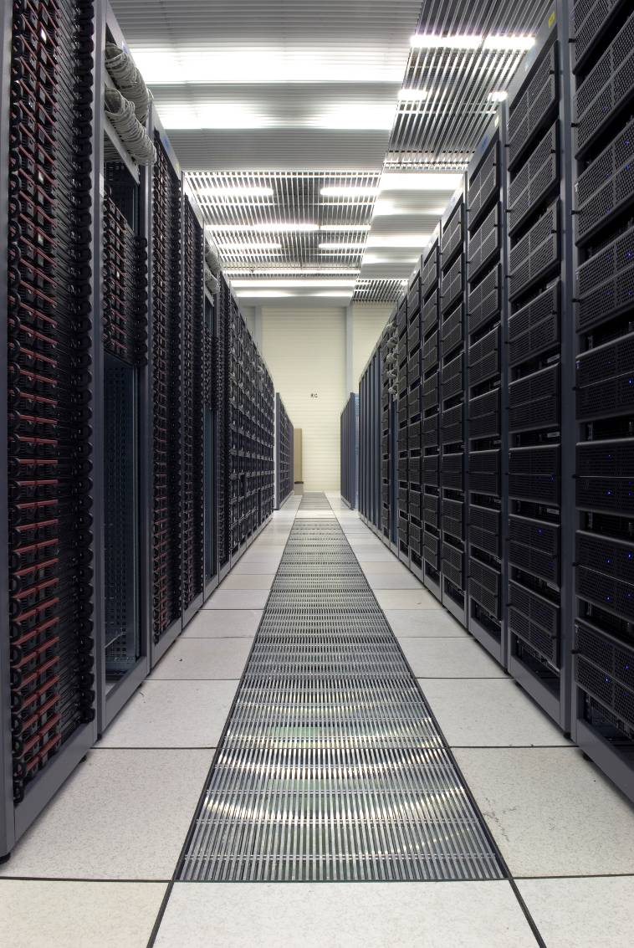
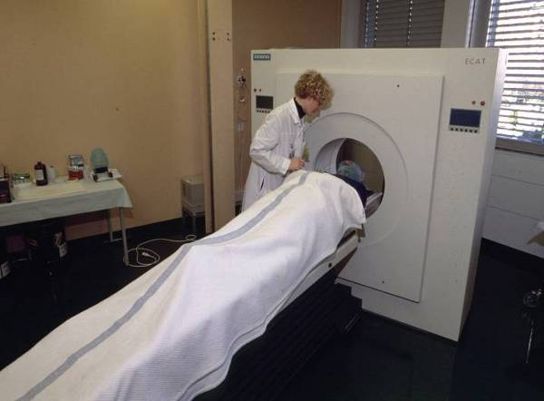
Spin off technology ….
Computer technology
  The World Wide Web
  The Computer Grid
Detector technology
  Radiation treatments
  Medical instrumentation
Nuclear waste disposal
  Transmutation
Superconducting magnets
Electronics
......

Slide 43
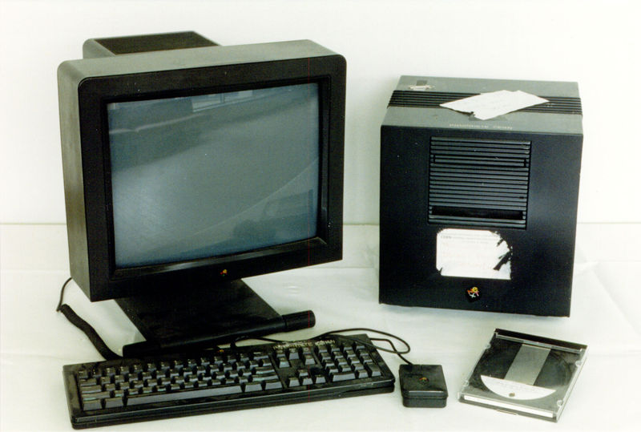
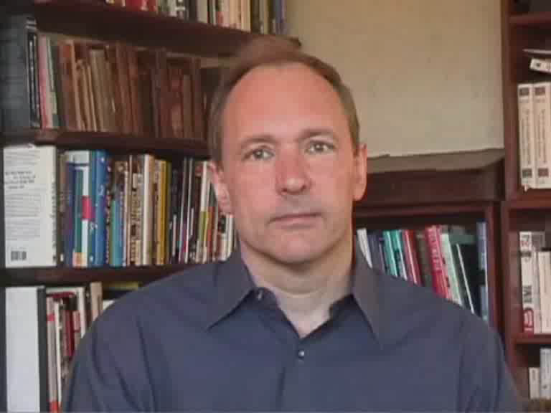
The World Wide Web
The most important spin-off from particle physics is the World
Wide Web. It was invented at CERN as a way for physicists to share information on computers in different countries.
The worlds first web-server.
Tim Berners-Lee, the inventor of the World Wide Web.

Slide 44
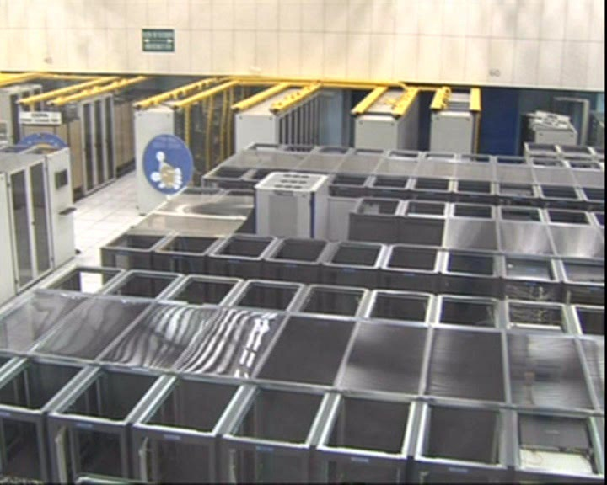
The new computer project is the grid.
The Worldwide LHC Computing Grid has been developed in order for physicist around the world to have sufficient computer power and in order for them to get hold of the 15 million Gigabytes of data that the LHC will produce each year.

Slide 45

Finally, the most common question:
All this sounds very complicated and expensive, but what is the purpose of the whole thing ? Of what practical use is this research ?
There are two standard answers to this question:
Michael Faraday in 1830 to Queen Victoria: Madam, of what use is a baby ?
We will (probably) never have any practical use of this basic research !
The main purpose is to understand the world we live in in the same way as the pictures from the Hubble telescope give us new knowledge that has no practical applications.
The Sombrero galaxy (Hubble telescope)
Vincent Hedberg - Lund University
45

Slide 46


Slide 47


Slide 48


Slide 49


Slide 50


